Slide 1
SMD Project

Slide 2
Index.
Usage
Components
Diagram
Data sheet
How it works
References

Slide 3
Usage.
A metal detector is an electronic instrument which detects the presence of metal nearby.
Metal detectors are useful for finding metal inclusions hidden within objects, or metal objects buried underground.

Slide 4
Components.
It consists of :
+9 supply voltage.
IC 555 timer.
2.2uF Capacitors (Two pieces).
10uF Capacitor.
One resistance (47k Ohm).
150 turns of 10cm diameter coil (any gauge would work).
Speaker (8 Ohm).

Slide 5
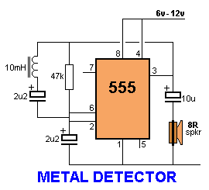
Diagram.

Slide 6
Data sheet
IC 555 timer:
Acts as square wave generator that generates pulses with frequencies audible to human.
Capacitors:
Store electric energy when they are connected to a battery . They are commonly placed in electronic components and are used to maintain a power supply while the device is unplugged and without battery for a short time.

Slide 7
Resistance:
Are used to limit current flow ,adjust signal level and to divide voltages.
Coil:
It creates a magnetic field that feels
metal

Slide 8
How it works.
the IC 555 timer acts as square wave generator that generates pulses with frequencies audible to human , the ( RLC ) part in the circuit is the metal detection part and the inductor is an airport one so when a metal piece is brought near to this coil this results in increase in the inductance of the coil ,

Slide 9
with the sudden increase in inductance of the coil the impedance of the ( RLC ) circuit changes . So when there is no metal piece near to the coil the signal fade to the speaker causes some audible sounds and with the change in reactance around the ( RLC ) circuit the signal sent to this speaker will be different than the first one so the frequency changes makes different sound.

Slide 10
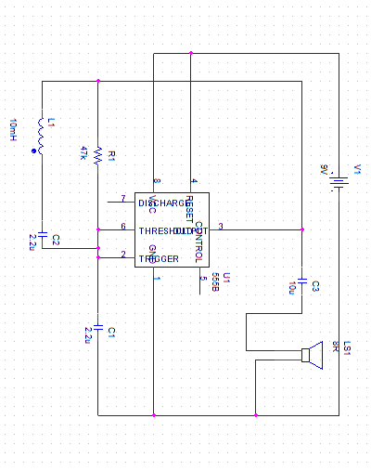
original orcad circuit.

Slide 11
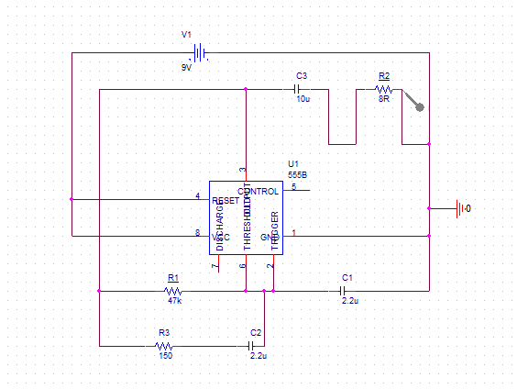
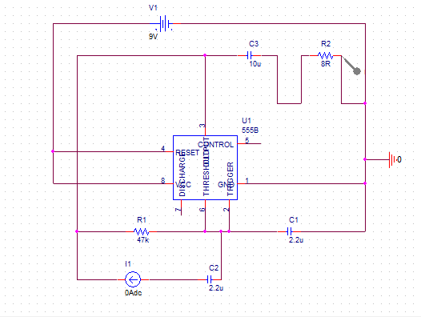
Second orcad circuit.
1
2

Slide 12
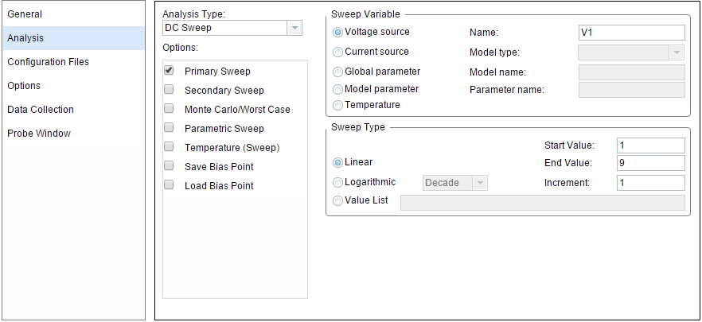
Sweep settings

Slide 13
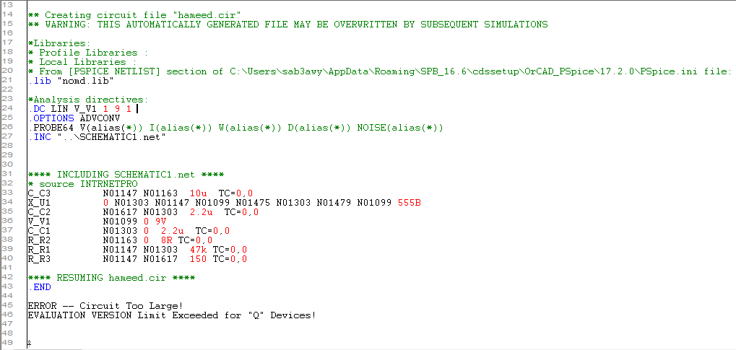
Simulation run
1

Slide 14
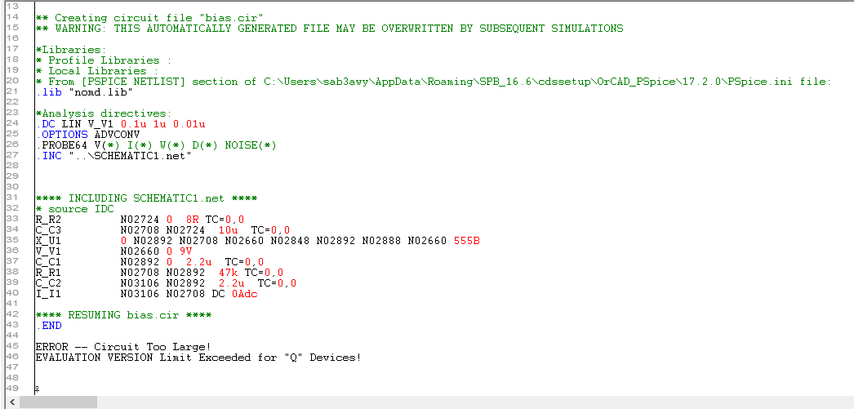
2

Slide 15
References
Wikipedia: Metal detector.
Instructable: How to make a Metal detector.
Circuitdigest: Simple metal detector circuit.

Slide 16
end

